Slide 1

Quest:
Shark Attack
Alex A. Ortiz Cotto
Alejandro Llera Fábregas

Slide 2
Unveiling Shark Attack Trends: Dataset Evaluation & Analysis
Dataset & Hypothesis Formulation:
Hypothesis : "Shark attacks have increased over the years in specific regions."
Initially, the dataset arrived clean and complete. Subsequent testing of functions corroborated our formulated hypothesis, focusing on assessing various types of shark attacks by year and country. Drawing from historical data, the hypothesis posited an expectation of witnessing one shark attack annually spanning 1818 to 2022.
Data Cleaning and Analysis Process:
Our analysis began with graphically mapping shark attacks from 1818 to 2022, showcasing a discernible rise in incidents each year. This visual representation was pivotal in data refinement and confirming our established hypothesis.
Distinctive Data Cleaning Techniques:
Post-extraction, our initial data cleaning phase involved eliminating blank rows to ensure data integrity. Subsequently, zeros were transformed to null values, and 'Year' entries were converted from 'int' to 'float.' Further analysis addressed blank entries in specific variables, critical for predicting missing information and its subsequent impact on the analysis outcomes.

Slide 3
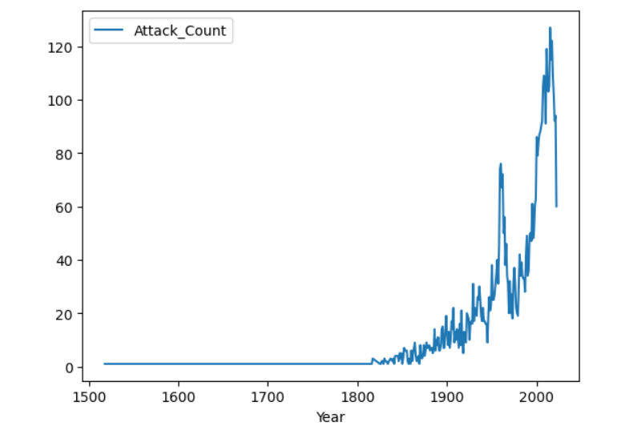
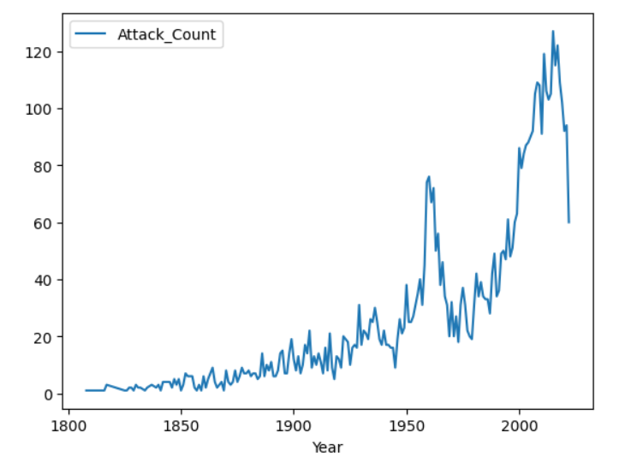
Graph of Shark Attacks per Year
All Years in the DataFrame
Years in the DataFrame focus

Slide 4
Refinement Through Data Wrangling
Encountered Challenges in Data Cleaning:
A significant challenge during data cleaning involved the need to categorize data into distinct columns and segregate it into separate variables to extract specific desired information.
Resolution of Challenges:
To address these complexities, a new variable was crafted within the original dataset, streamlining the data for enhanced readability and ease of analysis. Various functions such as "Change year," "Apply," "Sorted_Values," and "DropNa" were instrumental in this data cleaning process. Specifically, these functions facilitated the conversion of the 'Year' column into numerical values, effectively resolving the initial challenges encountered with the raw dataset.

Slide 5
Insights Through Exploratory Data Analysis
Utilized Data Analysis Methods:
Throughout the cleaning and analysis phases, various methods were employed, including "Apply," "Sorted_Values," "DropNa," "Reset_index," and 'Value_counts."
Uncovered Insights and Patterns:
A notable revelation emerged during analysis, spotlighting analogous activities across columns such as country, state, and location, showcasing similar or even indices. This observation significantly contributed to the depth and outcomes of the analysis, elucidating intriguing patterns within the dataset.

Slide 6
Navigating the Principal Hurdle
Encountering the Primary challenge:
The most significant hurdle faced in this project revolved around transforming the strings in the column of year to the int format. Additionally, identifying the diverse relationships among variables was pivotal in validating our hypothesis.
Learnings and Overcoming challenges:
This project facilitated an invaluable learning curve of data extraction, meticulous data cleaning, and the manipulation of variables to derive meaning outcomes. The process transforming existing data, crafting new variables, and ultimately navigating the complexities to attain desired insights.

Slide 7
Conclusions and Revelations
Overview of Outcomes:
Following the modifications of the original dataset, creating a new variable and transforming the year column. The results revealed a consistent escalation shark attacks annually, affirming our initial hypothesis.
Surprising Insights and Revelations:
A noteworthy discovery emerged when addressing missing values within the rows or columns, significantly altering the outcomes post-elimination, thereby changing the impact of such omissions on the analytical results.
Potential implications of Findings:
The implications of null value elimination were paramount, changing its substantial influence on the data analysis outcomes. This shows the handling of missing data, acknowledging its potential to be reshape and the impact of conclusions drawn from the analysis.

Slide 8
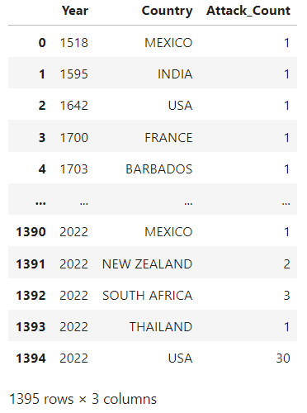
Number of Shark Attacks that occurred in each Country per Year

Slide 9
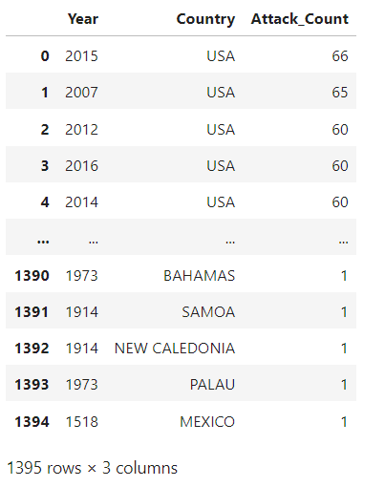
High Shark Attacks that occurred in a Country per Year

Slide 10
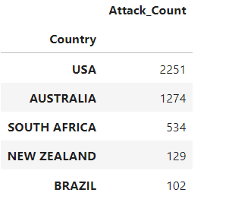
Top 5 Countries that have high Shark Attacks

Slide 11
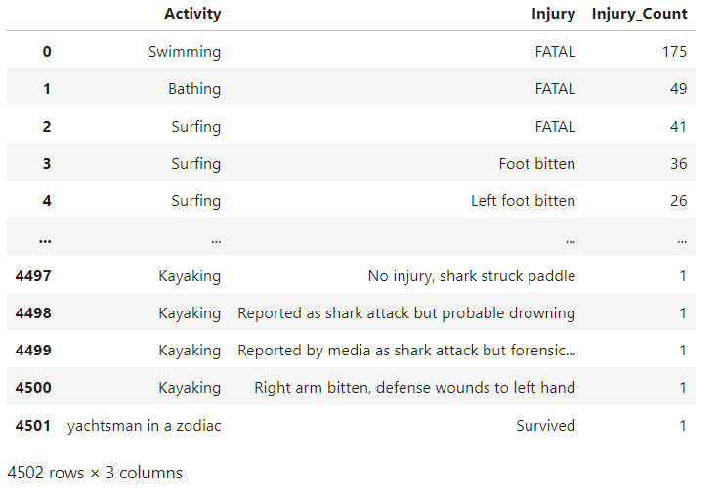
Types of Injuries that occured related to an Activity

Slide 12
Quest: Shark Attack Conclusion
Thank You for your attention!

